Slide 1

Adelaide Navigator
Dream, Flash, Stephanie
Notes:
Hello everyone, our group is Adelaide Navigator. Today, we are going to introduce a better navigation app designed for pedestrians. You might ask, Better in what way? Well, imagine you’re walking through unfamiliar streets without the proper navigation tools. Then imagine you’re getting turned around because your compass was pointing in the wrong direction, leading you to walk the wrong way and you didn’t realise until you’re too far in the wrong direction.
Frustrating right?
Enter the Adelaide Navigator. Specifically designed for Adelaide’s narrow, winding, twisting streets. Now you’ll always get there on time with no hassle.
In this presentation, we’ll be discussing the prototype along with the features and solutions we have come up with to solve our general problem. We’ll also share some challenges we faced during production as well as any possible future extensions.

Slide 2

Problem Statement
WHAT ISSUE DID YOU IDENTIFY?
1
Inaccurate Compass
2
Safety Issues
3
Poor indoor & multilevel navigation
4
No Subtle Cues
Notes:
Some issues we've identified with the already available navigation apps on the market are as follows...
Like we established, the compass can be inaccurate, especially in dense city areas and the app can sometimes rotate unpredictably making it hard to know which way to start walking.
It doesn’t consider sidewalk quality, shade, safety, or crowdedness.
Poor indoor navigation (through malls or campuses)
Limited accessibility features for people with mobility or vision impairments.
No subtle cues (like haptic feedback or clearer facing-direction indicators) to help when you’re holding the phone down

Slide 3

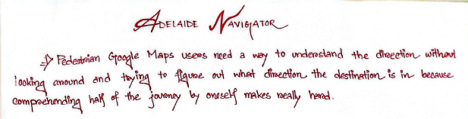
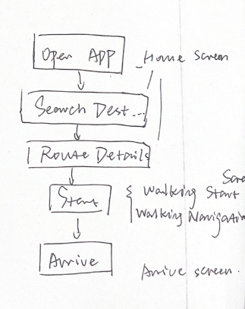
Ideation Process
HOW DID YOU BRAINSTORM AND CHOOSE IDEAS?
Phase 1
Phase 3
Wrote out our problem statement
Sketched out the wireframe on paper
Phase 2
Phase 4
Brainstorm for solutions
Created a mock-up on Figma

Slide 4
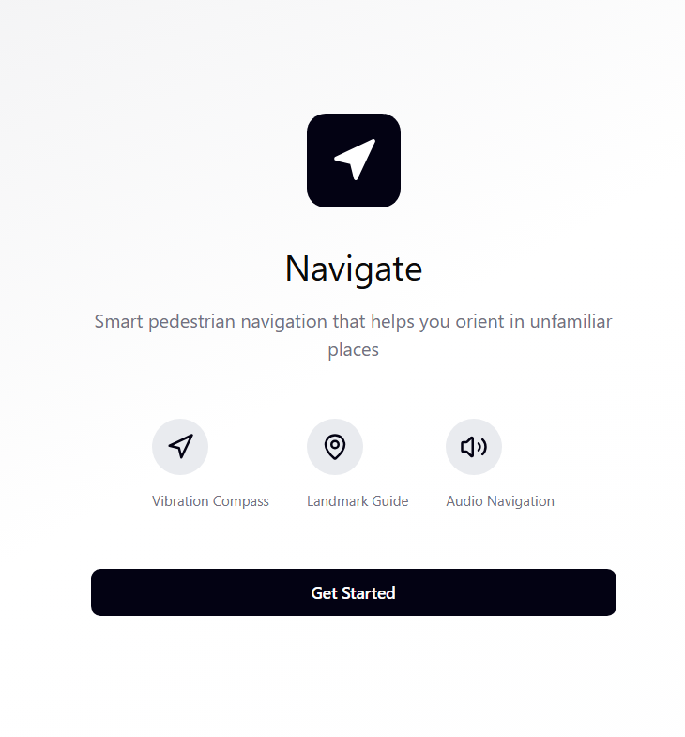
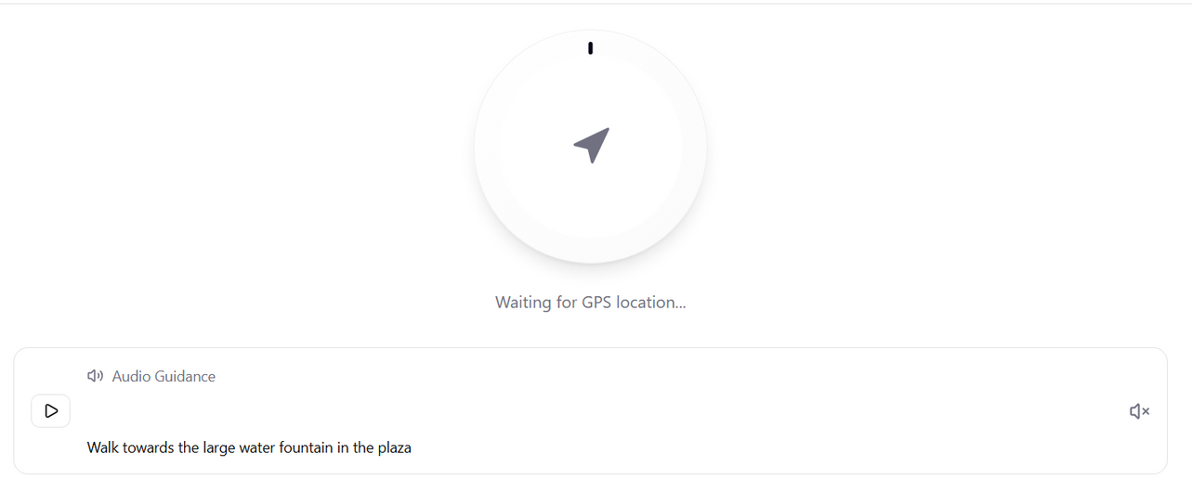
Prototypes
WHAT SOLUTIONS DID YOU CREATE?
Vibration Compass, Landmark Anchoring,
Audio Navigation
1

Slide 5
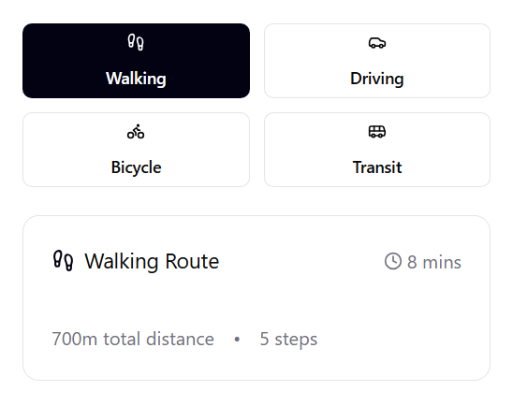
Prototypes
WHAT SOLUTIONS DID YOU CREATE?
2
Different Travel Modes

Slide 6
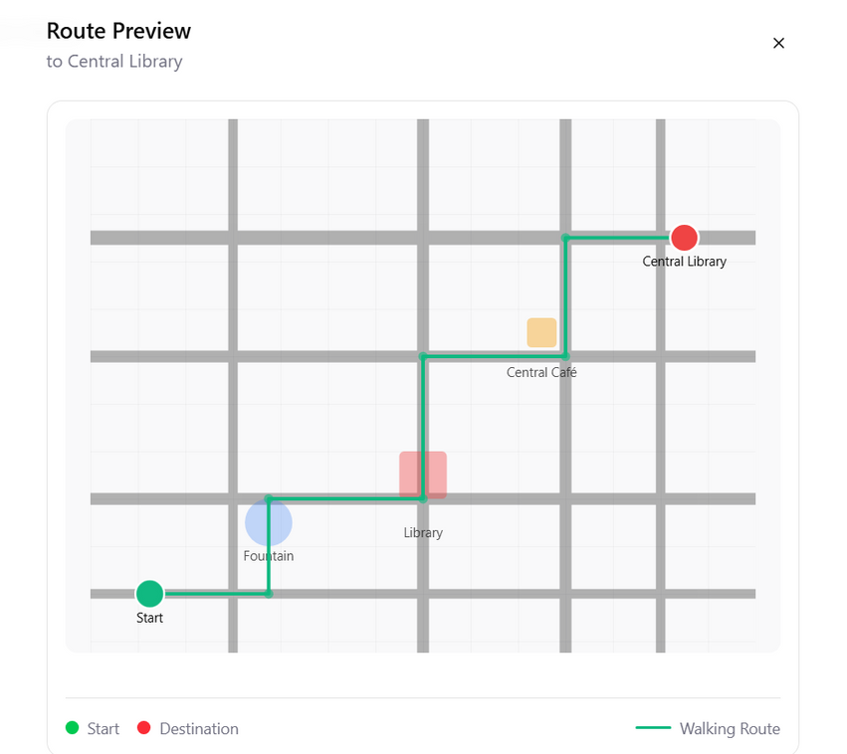
Prototypes
WHAT SOLUTIONS DID YOU CREATE?
3
Map Preview

Slide 7
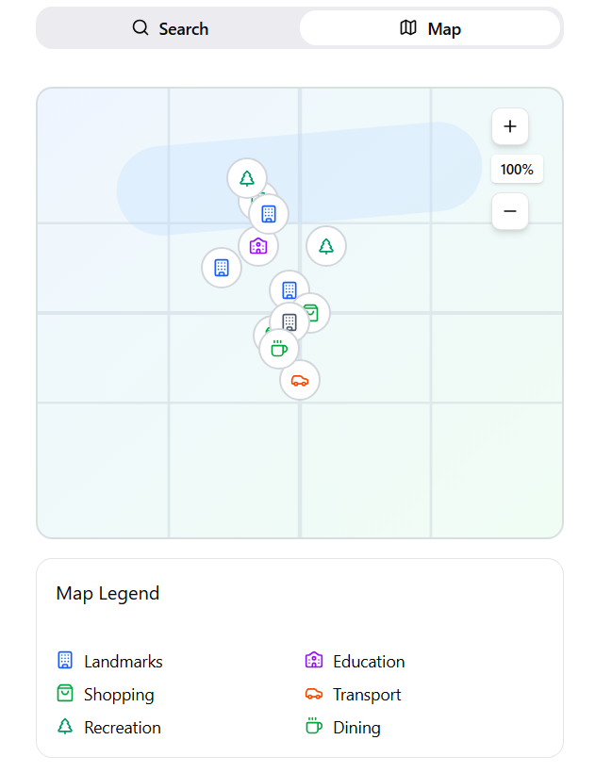
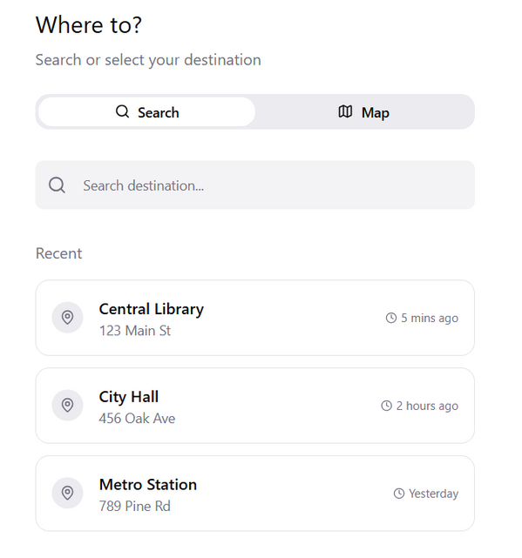
Prototypes
WHAT SOLUTIONS DID YOU CREATE?
4
History and Popular Locations

Slide 8


Testing & Feedback
WHAT WORKED, WHAT DIDN’T, AND HOW FEEDBACK SHAPED YOUR SOLUTION.
1
Switch to pedestrian-focused app?
2
More accessibility options?
3
Street view?
Notes:
During our testing and feedback stage, we received some helpful notes from our fellow classmates.
Mainly it was about how we could target it more towards the pedestrians as the navigation apps on the current market are more catered for drivers and we agree. For such a walkable city like Adelaide, it can also help encourage people to walk more and not depend on their cars.
There was also the question of street view and if we would include more accessibility options.

Slide 9
Solution
Adelaide Navigator

Slide 10

Reflection - Key Learning
Key learning, challenges, and possible future directions.
1
Critical Thinking
2
Problem Solving
3
Software Development Process

Slide 11
Reflection - Challenges
Key learning, challenges, and possible future directions.
1
Building a prototype for the first time
2
Create a UI that is not overwhelming
3
Realistic goals

Slide 12



Reflection - Future Directions
Key learning, challenges, and possible future directions.
1
Gamify it?
2
Add satellite views?
3
AI use for optimization?
Notes:
I believe there's a lot of potential for our idea as we can possibly gamify it, which may interest a broader audience. Turning it into something like those fitness apps may encourage people to walk more.
There's also the idea to incorporate satellite views and AI, where the AI can automatically scan through the data from the satellite to identify any streets that may need fixing and avoid suggesting those paths on the routes.

Slide 13
Conclusion

Slide 14
The End
THANK YOU FOR LISTENING – ANY QUESTIONS?
Adelaide Navigator

